Slide 1
Alkali-Sulfur-Chlorine Balance Introduction
Technical Development Program SPREAD 2016

Slide 2
Objectives and Scope
Objectives
Consistency check of mass flows- and laboratory data (e.g. mass balance and chemical analysis)
Assessment of coating and blockage problems
Assessment of fuel mix (e.g. additional petcoke or AFR potential, short- and long-term fuel mix planning)
Scope
Overall mass balance and individual balances for alkali (K₂O, Na₂O), sulfur and chlorine
Assessment of alkali, sulfur and chlorine inputs
Assessment of molar (Alk-Cl)/S-ratio
Assessment of hot meal (e.g. sulfur volatilization)
Balance can be extended to other critical elements if required (e.g. P₂O₅)

Slide 3
Basic principle
Under stable conditions :
Mass_{input} = Mass_{output}
Alk_{input} = Alk_{output}
SO_{3 input} = SO_{3 output}
Cl_{input} = Cl_{output}

Slide 4
Preconditions and balance duration
The condition of the kiln needs to be stable
No kiln stop, fuel mix or raw mix changes in the last 24 hours
Stable build-up and coating situation
Typical clinker free lime (no cold kiln)
The duration of the balance depends on the objectives
Minimum 8 hours (better 24 hours) with hourly sampling to investigate temporary coating and blockage problems
With weekly, monthly or yearly averages for short-, medium or long-term planning of fuel mix

Slide 5
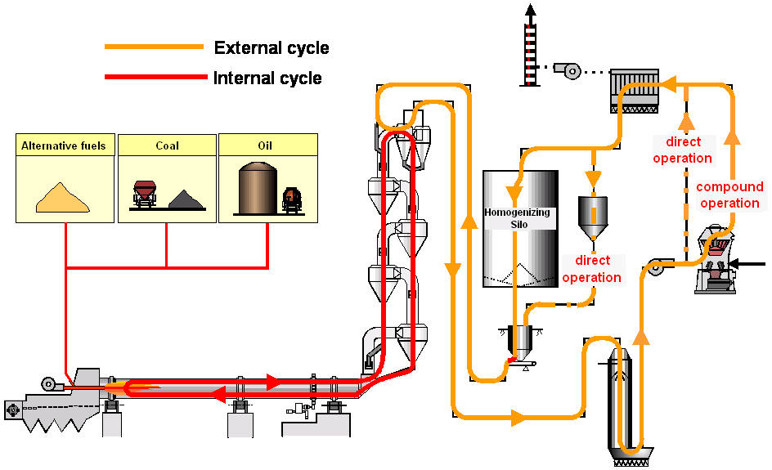
Balance boundary?
Emissions
Discarded Dust
Fuels
Raw Materials
Clinker

Slide 6

A: Kiln System & Raw Material Preparation
Fuels
Emissions: SO₂, HCl
Raw Materials (pure; before mill !)
Dust discarded (e.g. added to cement)
Clinker
Balance Boundary

Slide 7
B: Kiln System
Emissions: SO₂, HCl
Other input: = fuels + dust injection
Kiln feed as fed (!): = raw meal (on dry) + recycled filter dust
Balance Boundary
Clinker as measured
Bypass dust (LEPOL grate dust): removed from system (e.g. to cement)

Slide 8
Balance boundary comparison
Boundary A
The concentrations of alkalis, sulfur and chlorine coming from the raw materials are not influenced by the dust from the kiln
Representative sampling and sample preparation of each raw material (before the mill; un-ground!) is difficult (except in case of wet preparation)
Internal storage effects are not considered
Boundary B
Representative sampling and sample preparation of the kiln feed and filter dust is comparatively simple
The concentrations of alkalis, sulfur and chlorine in the kiln feed are influenced by the dust from the kiln (during raw meal grinding, dust recirculation)

Slide 9
Material sampling
Boundary A
Individual raw material components (e.g. blast hole samples)
Fuels
Clinker
Filter dust (during direct operation for dry kilns)
Bypass dust
Hot meal (bottom cyclone stage)
Boundary B
Kiln feed (incl. recirculated filter dust for dry kilns)
Fuels
Clinker
Filter dust
Bypass dust
Hot meal (bottom cyclone stage)

Slide 10
Material analysis
Kiln feed, clinker, filter dust, bypass dust, hot meal
SO₃, Na₂O, K₂O, (Cl) by XRF
Cl by titration!
LOI by loss in weight in furnace
H₂O by loss in weight in furnace
Fuels
S by sulfur analyzer (e.g. Leco)
Na₂O, K₂O from ash analysis by XRF
Cl by titration (extract from calorimeter bomb)
H₂O by loss in weight or Karl-Fischer for AFR
Ash content by loss in weight in furnace
CV by bomb calorimeter
Ultimate analysis by H-C-N analyzer

Slide 11
Additional data
Mass flows
Filter dust and bypass dust from measurement
Kiln feed and fuels from CCR
Clinker by calculation
Process & emission data
Emissions data (SO₂, HCl) during direct operation
Hourly kiln process data
Minute data for O₂/CO

Slide 12
Evaluation of results
Compilation of MS Excel Tool “Alk-S-Cl balance.xls”
Tool & Guideline available

Slide 13
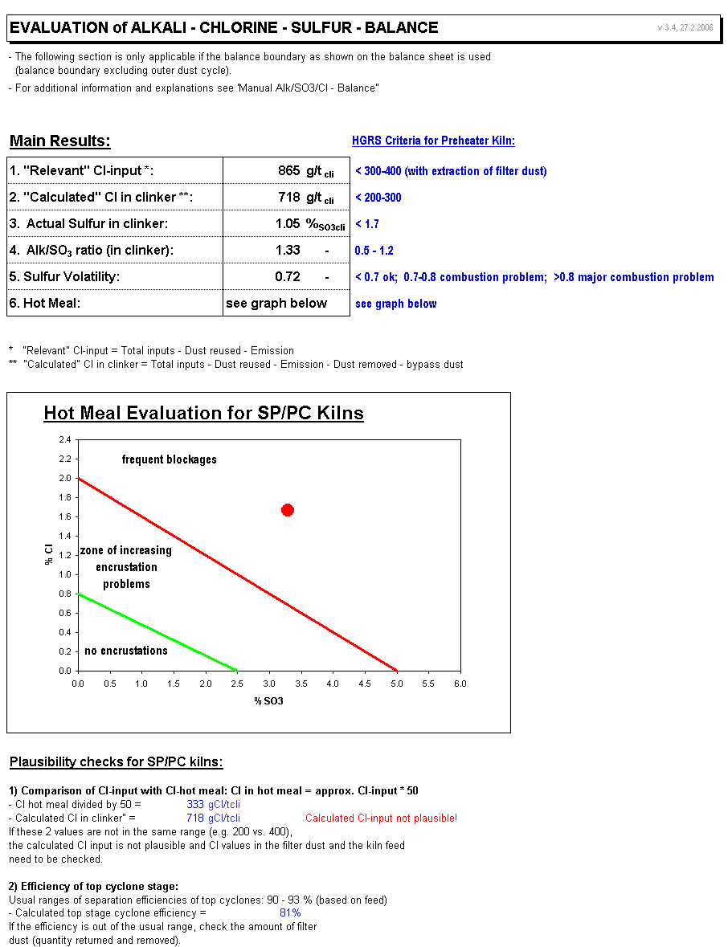
Evaluation of results
Comparison of actual numbers with guide values
Results of balance:
Relevant chlorine input
Sulfur input
SO₃/Alk-Ratio
Sulfur-volatility
“Hot meal graph”

